Slide 1
Smart Healthcare Appointment System
ER Diagrams

Slide 2
Team : Smart Healthcare Appointment System
List of Entities
Entity Name | Entity Primary Attributes
Users | userId, name, email, password, phone, address, state, zipcode, eName, specialityName
Zipcode | zipcode, city
State | stated, stateName
Entitlements | eId, eName
Appointments | appointmentId, patientId, doctorId, appointmentDate, status
Doctor_specialty | specialityId, specialityName
MedicalRecords | recordId, patientId, description, recordDate
Prescriptions | prescriptionId, doctorId, patientId, medicine, issueDate
Invoices | invoiceId, appointmentId, amount, status, invoiceDate
InsuranceClaims | claimId, invoiceId, claimStatus, submissionDate
Payments | paymentId, invoiceId, method, status, paymentDate
Notifications | notificationId, userId, message, sentAt
AuditLogs | logId, userId, action, timestamp
Messages | MessageId, DoctorId, PatientId,MessageText, SentAt,IsRead

Slide 3
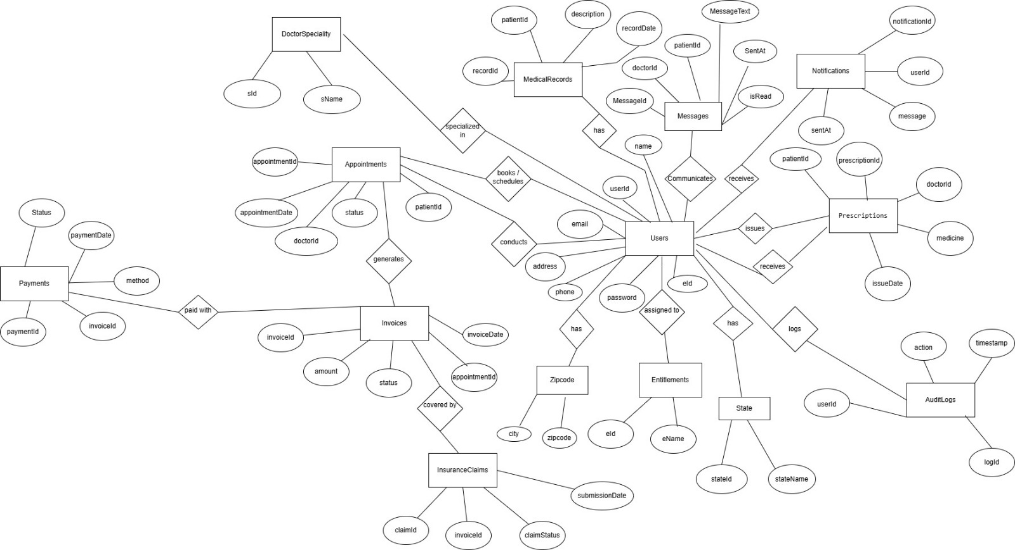
Team : Smart Healthcare Appointment System
Conceptual ER Diagram

Slide 4
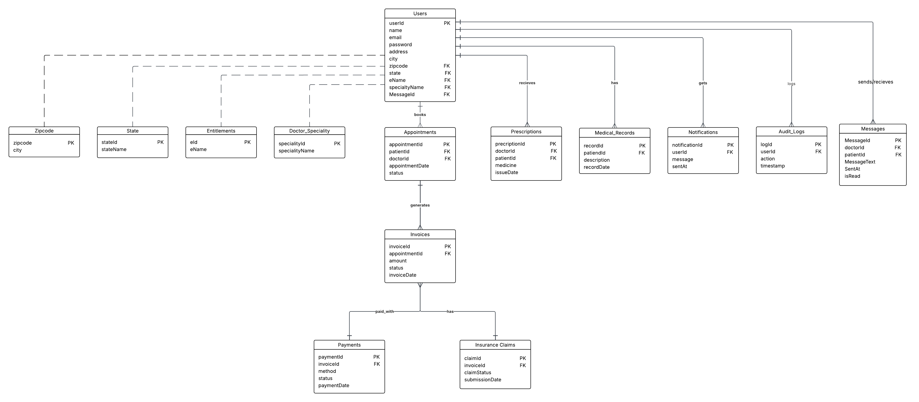
Team : Smart Healthcare Appointment System
Logical ER Diagram

